Slide 1
Optimizing Farm-to-table Supply Chain for Sustainable Fresh Food
Group Members:
Nilay Raut 002083164
Zening Teng 001534867
Jialun Tang 002308361

Slide 2
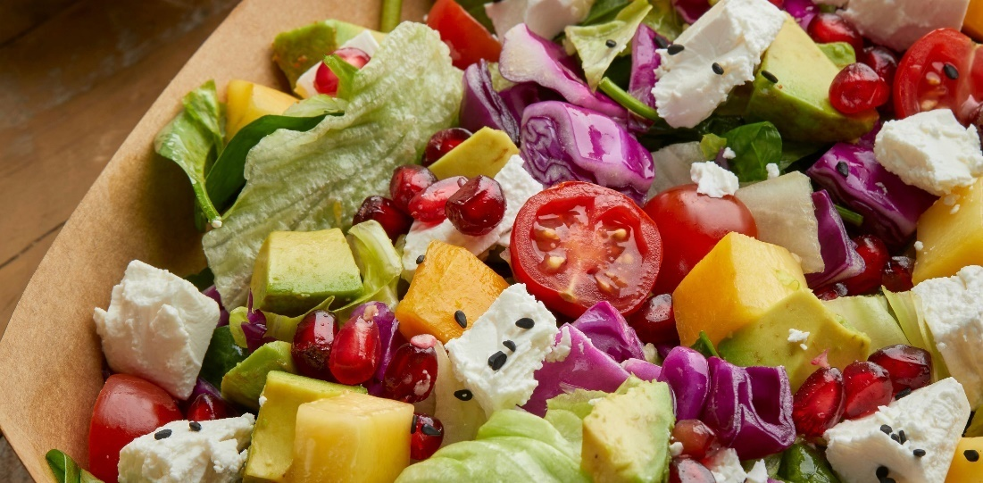
Optimizing farm-to-table supply chain for sustainable fresh food
Table of contents
Market Overview
Global trends in farm-to-table industries
Growth drivers across diverse sectors
Key global statistics and projections
Innovations and Tools
Leveraging IoT, AI, and blockchain for traceability
Advanced demand forecasting tools and techniques
Sustainable logistics practices
Table of contents
Current Challenges
Barriers in building efficient and sustainable supply chains
Gaps in stakeholder collaboration and resource optimization
Challenges in logistics and distribution networks
Impact Assessment
Economic benefits for farmers, producers, and consumers
Environmental advantages of reducing supply chain emissions
Enhancing food security and quality for communities
Solutions and Strategies
Scalable strategies for supply chain efficiency
Engagement with stakeholders in fresh produce, dairy, and livestock
Strengthening local networks for short supply chains
Case Studies and Best Practices
Successful farm-to-table businesses across various industries
Examples of improving local supply chain sustainability
Insights from industry pioneers

Slide 3

Table of contents Optimizing farm-to-table supply chain for sustainable fresh food
01
Admin
Role overview
Permissions and access levels
System configuration and management
Table of contents

Slide 4
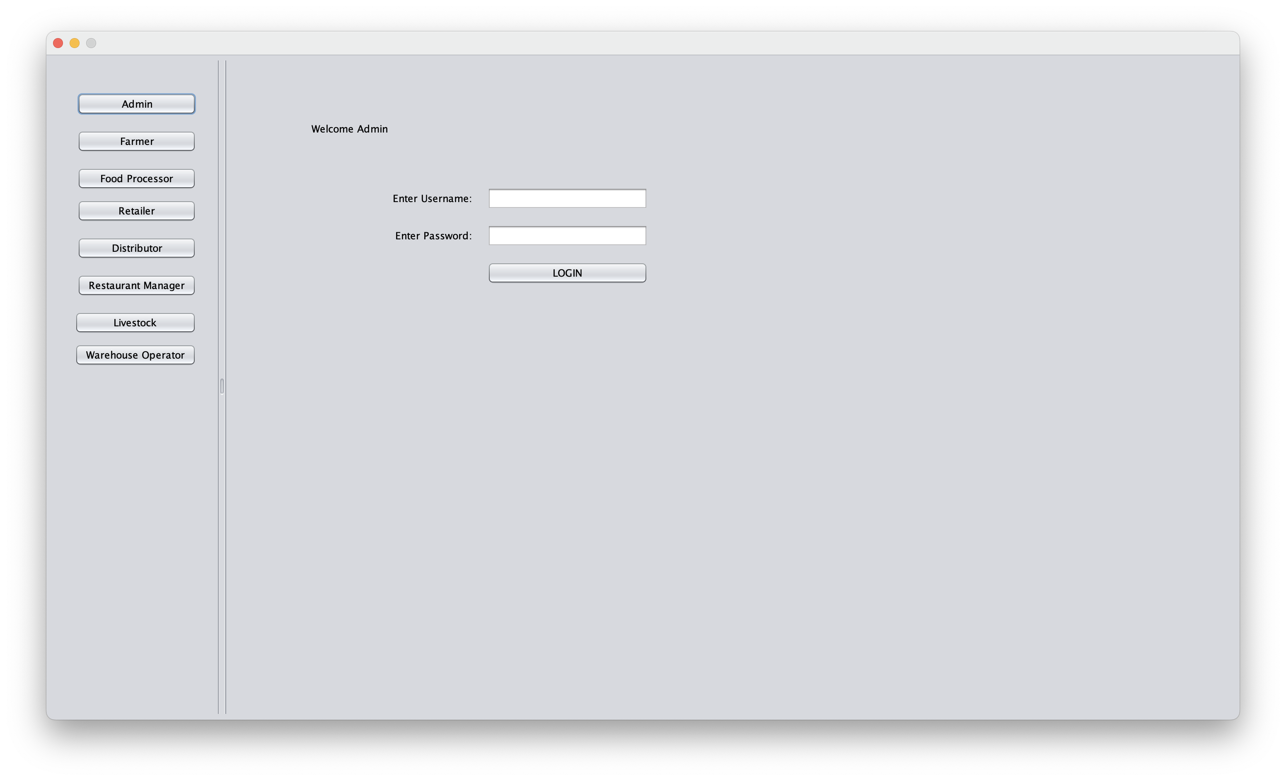
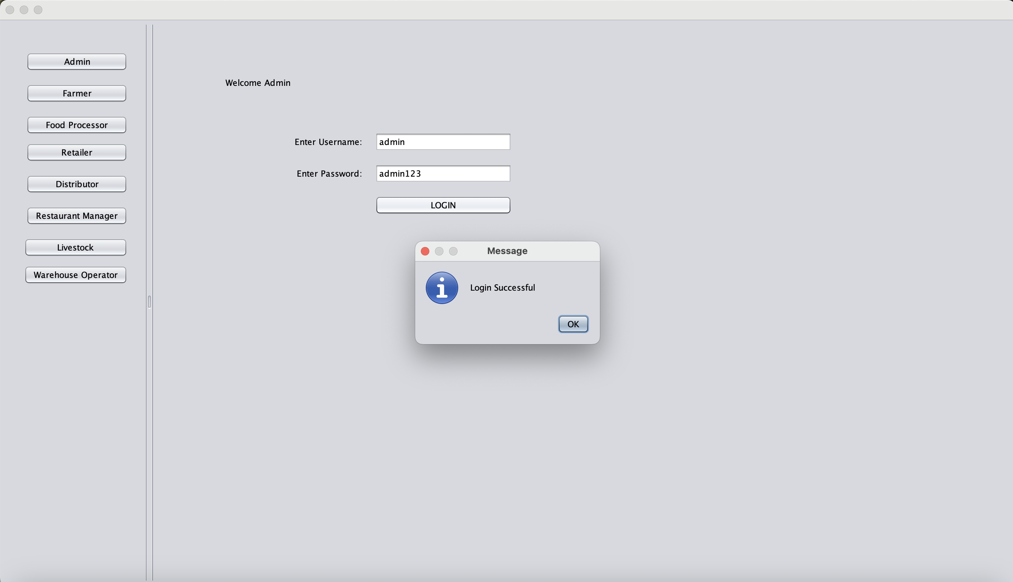

Food network
Admin
Role Overview: The admin oversees the entire system, ensuring smooth operations, assigning roles, and managing organizational access.
Permissions and Access Levels: Admins have the highest level of access, capable of modifying settings, assigning users, and overseeing reports.
System Configuration and Management: Responsible for configuring the system, including database connections, workflows, and managing integrations with external tools.

Slide 5
Table of contents Optimizing farm-to-table supply chain for sustainable fresh food
02
Farmer
Crop and livestock management
Market pricing and sales tracking
Sustainable farming practices
Table of contents

Slide 6
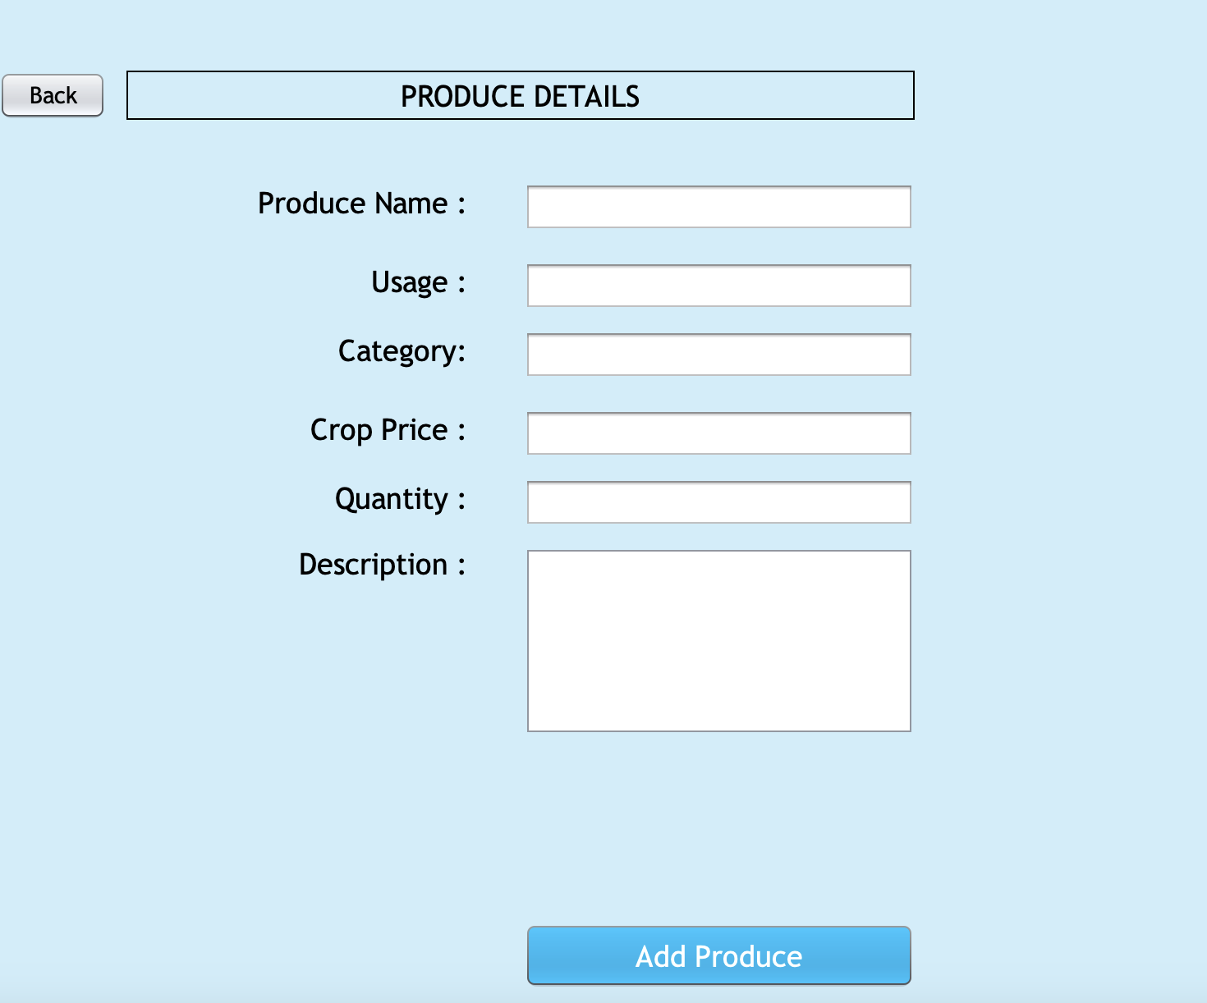
Food Network
Farmer
Crop and Livestock Management: Tools and strategies for managing crops and livestock, including planting schedules, animal care, and yield tracking.
Market Pricing and Sales Tracking: Access to current market trends, pricing data, and tools to monitor sales performance.
Sustainable Farming Practices: Resources and guidelines for adopting environmentally sustainable practices in farming.

Slide 7
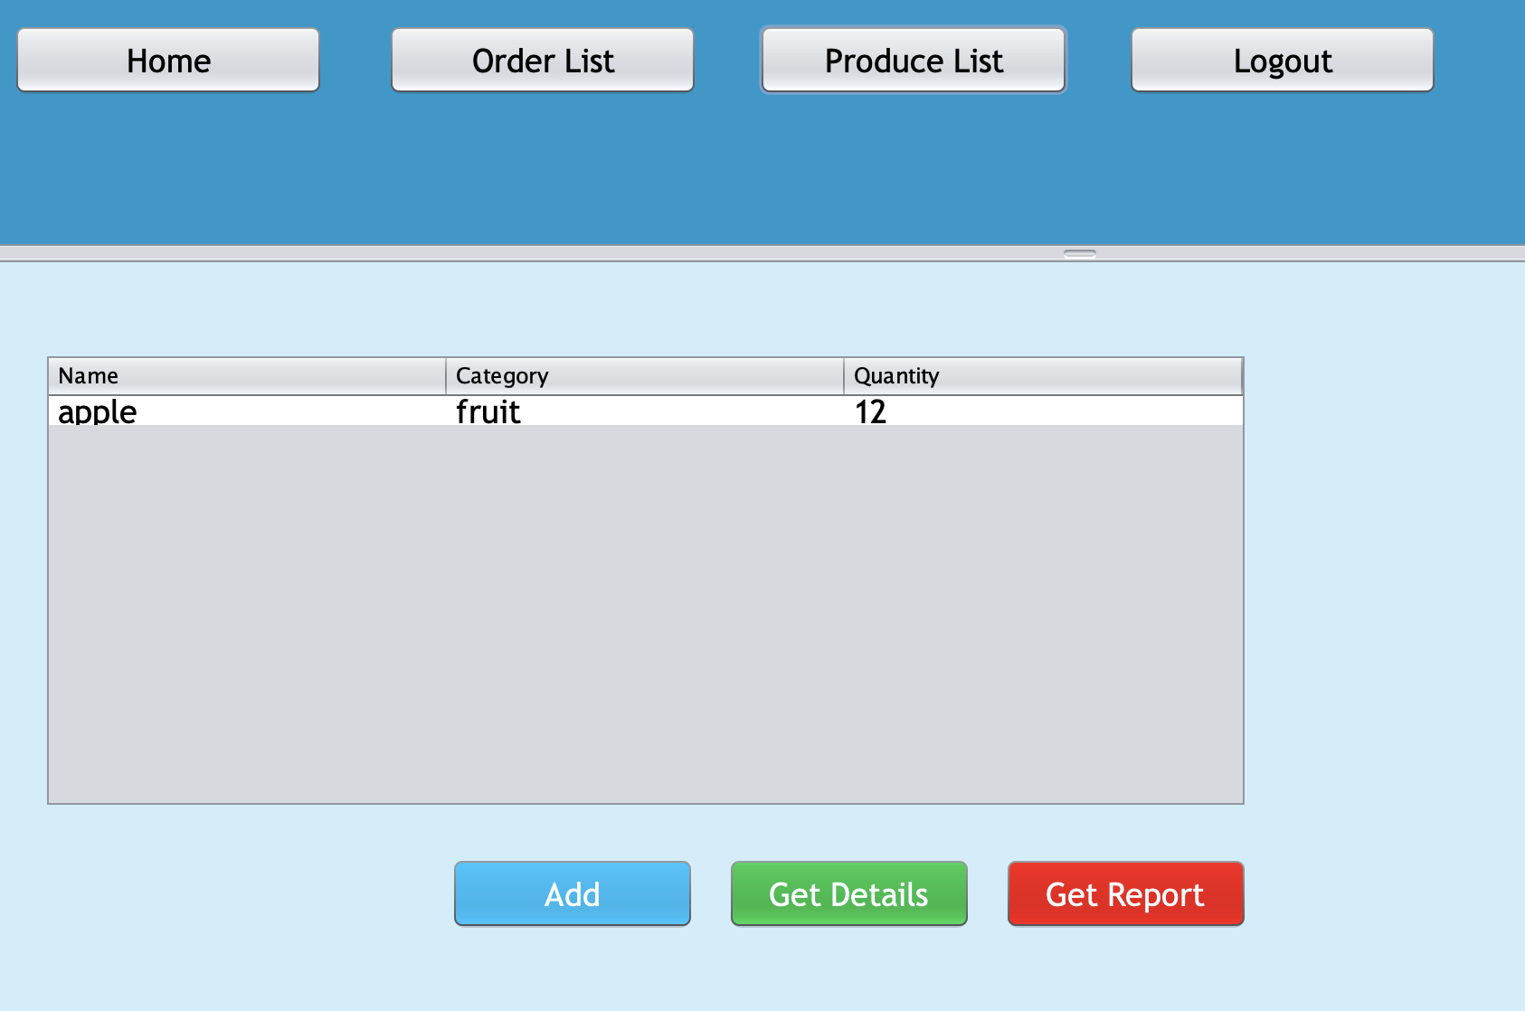
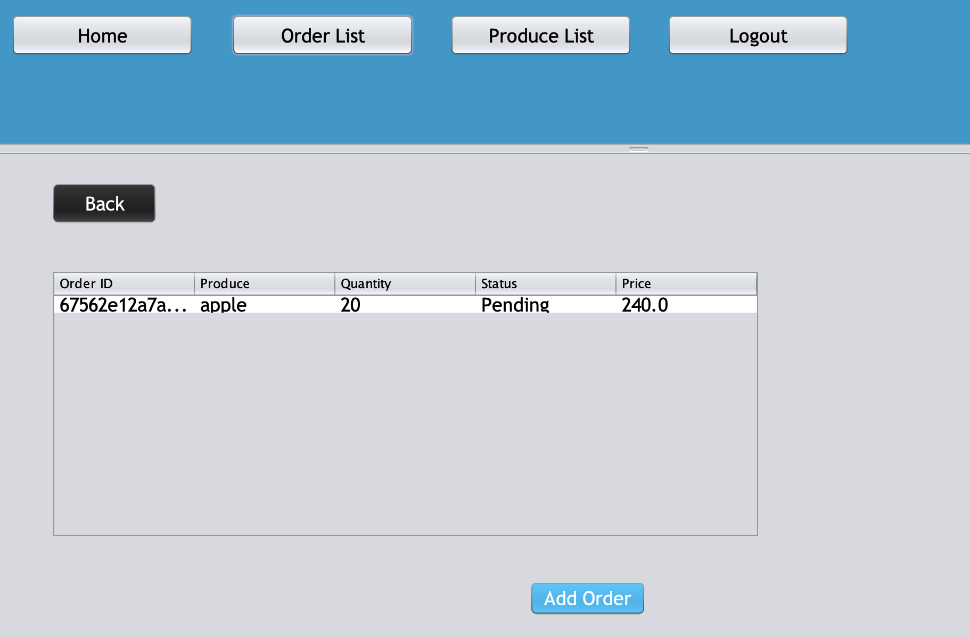
Food Network
Farmer
Crop and Livestock Management: Tools and strategies for managing crops and livestock, including planting schedules, animal care, and yield tracking.
Market Pricing and Sales Tracking: Access to current market trends, pricing data, and tools to monitor sales performance.
Sustainable Farming Practices: Resources and guidelines for adopting environmentally sustainable practices in farming.

Slide 8
Table of contents Optimizing farm-to-table supply chain for sustainable fresh food
03
Food Processor
Processing workflows
Compliance and safety standards
Supply chain integration
Table of contents

Slide 9
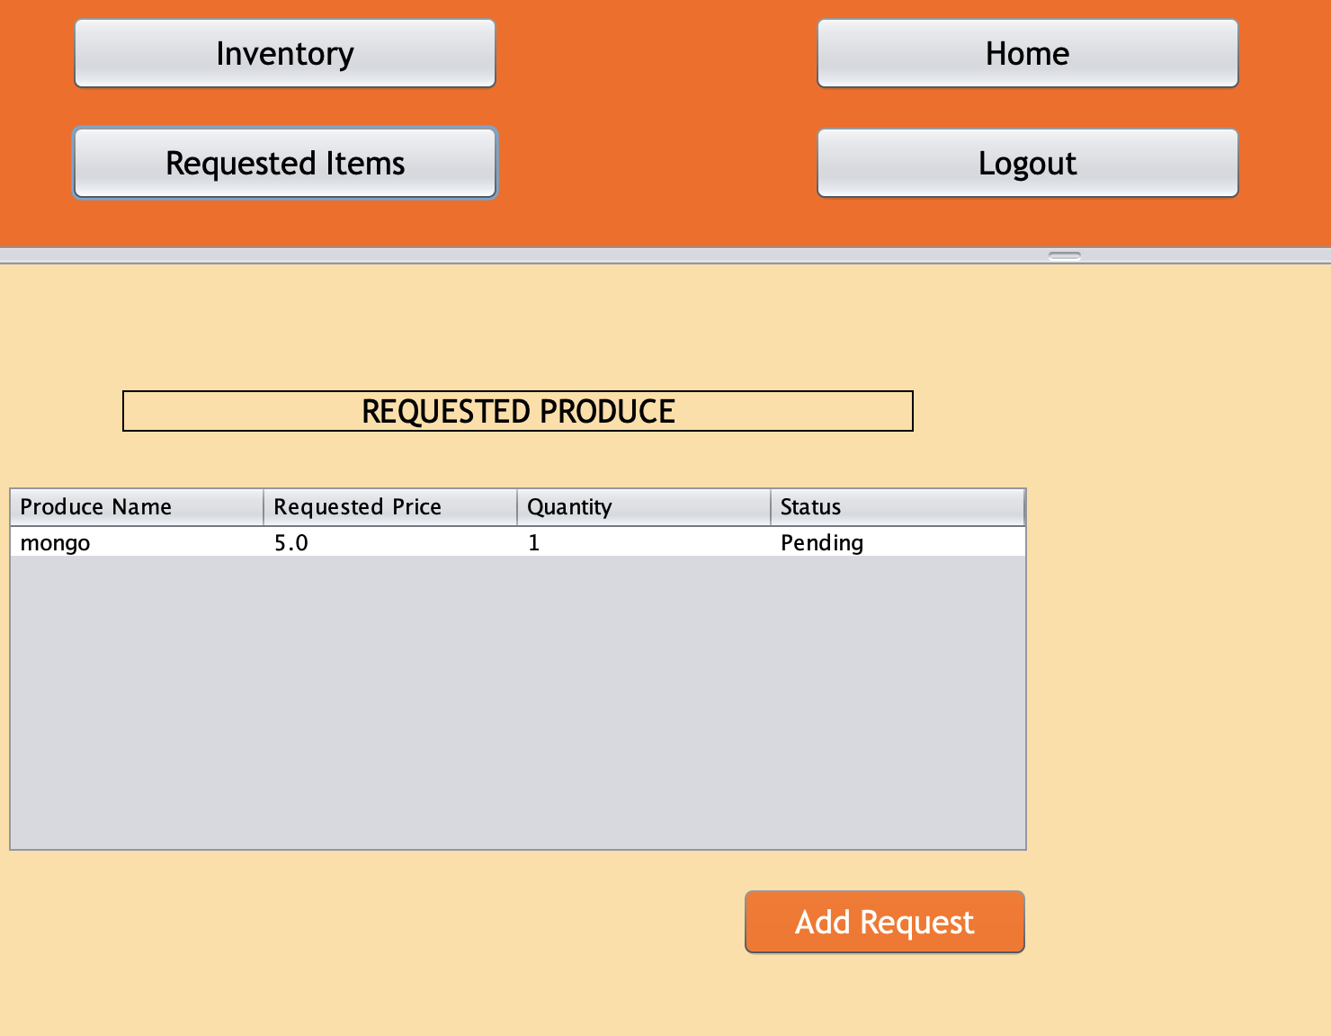
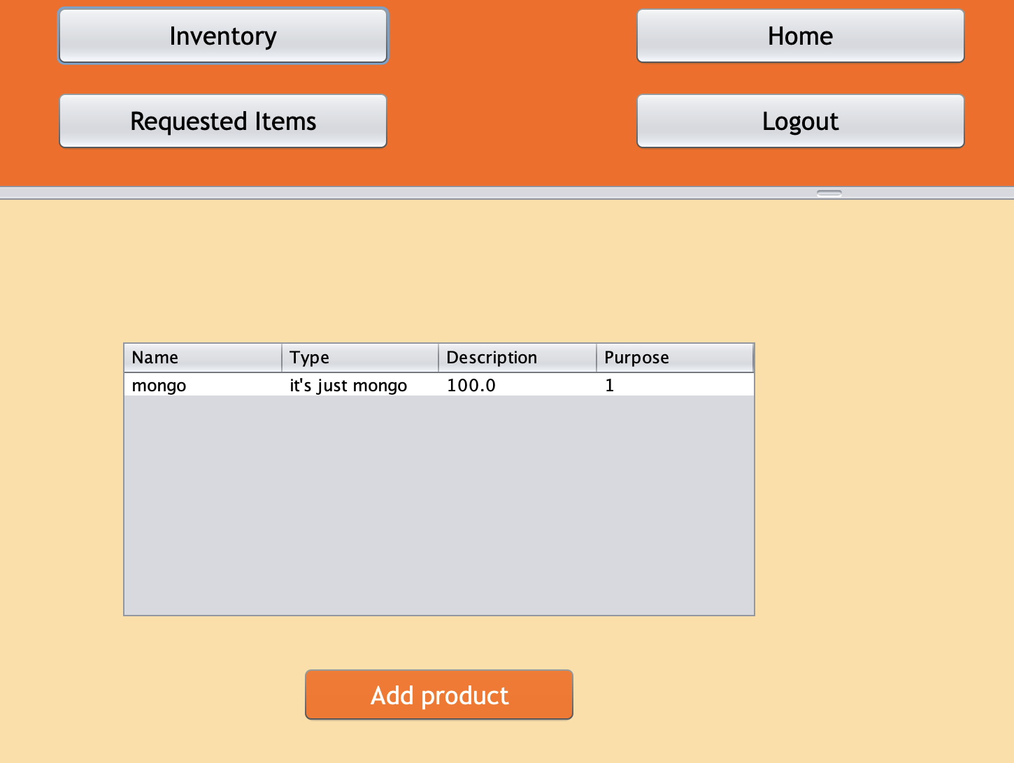
Food network
Food Processor
Processing Workflows: Automated workflows to process raw materials into finished food products efficiently.
Compliance and Safety Standards: Tools to ensure adherence to food safety laws and quality standards.
Supply Chain Integration: Linking processing units with farmers, distributors, and retailers for seamless supply chain operations.

Slide 10
Table of contents Optimizing farm-to-table supply chain for sustainable fresh food
04
Retailer
Inventory and sales management
Customer relationship strategies
Promotional activities and offers
Table of contents

Slide 11
Table of contents Optimizing farm-to-table supply chain for sustainable fresh food
05
Distributor
Logistics and transportation
Regional distribution networks
Real-time delivery tracking
Table of contents

Slide 12
Obstacles in building sustainable agriculture supply chains
Distributor
Logistics and Transportation: Efficient routing systems, vehicle tracking, and delivery schedules.
Regional Distribution Networks: Managing a network of distribution hubs for smooth regional operations.
Real-Time Delivery Tracking: Tracking systems for monitoring the status and location of deliveries in real time.

Slide 13
Table of contents Optimizing farm-to-table supply chain for sustainable fresh food
06
Restaurant Manager
Menu planning and supply management
Vendor relationships
Customer service optimization
Table of contents

Slide 14
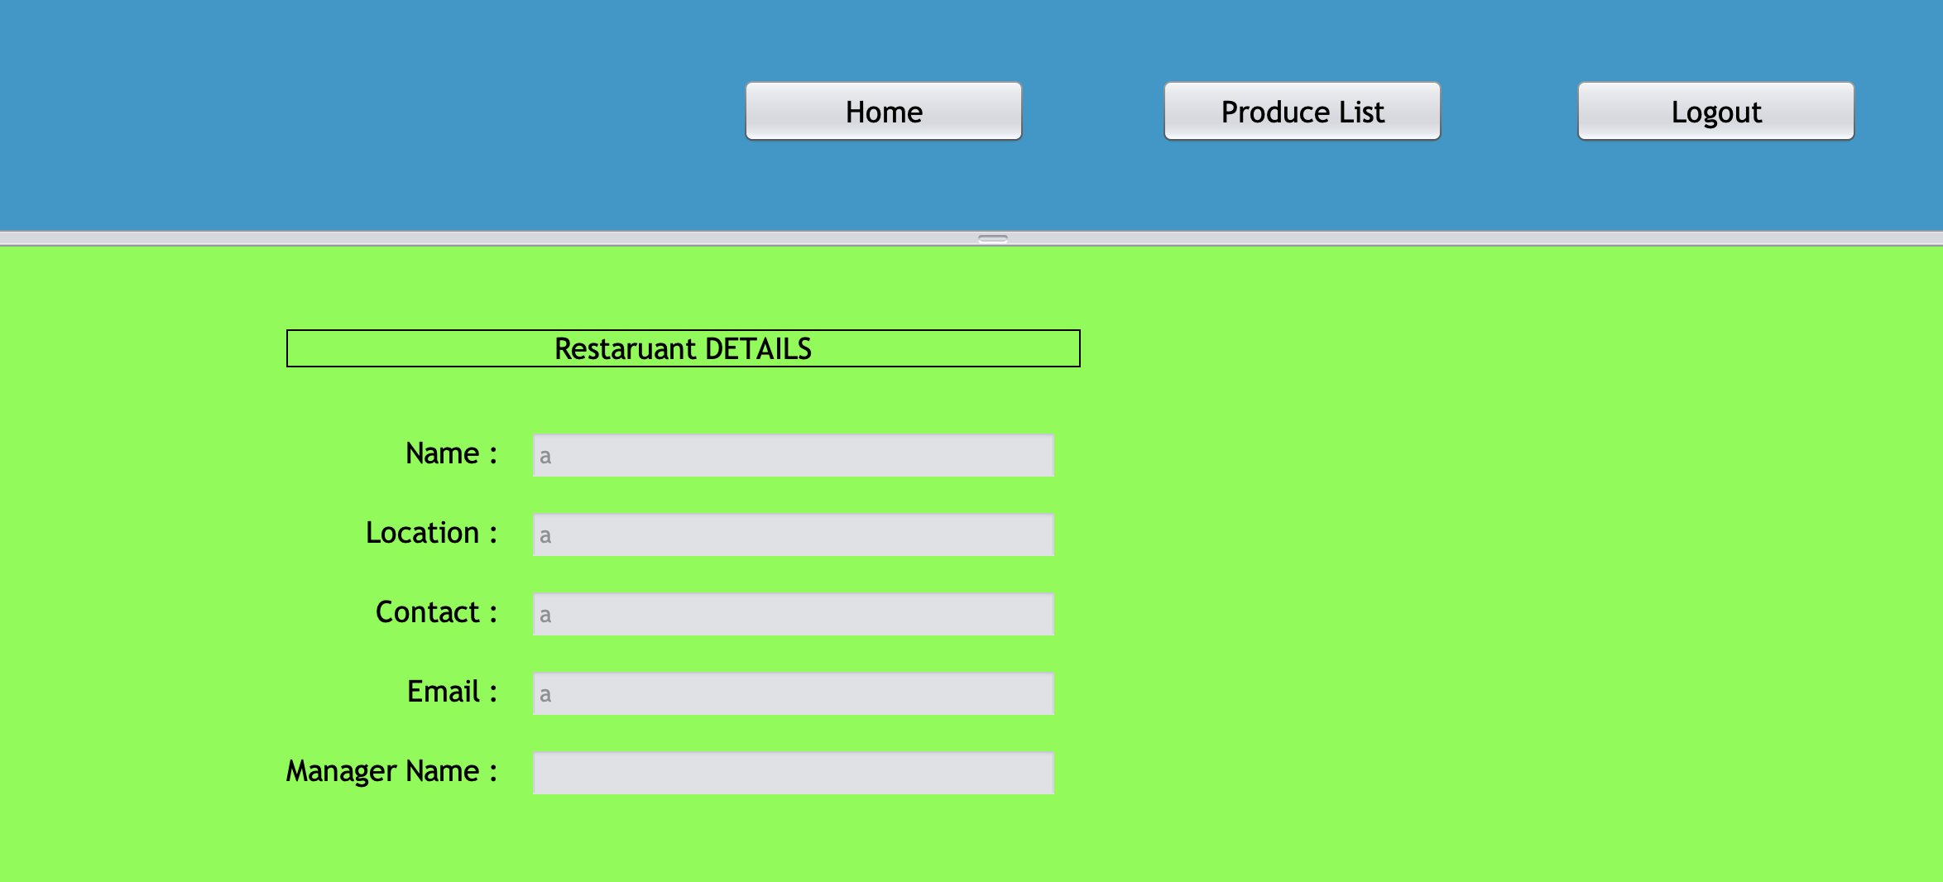
Obstacles in building sustainable agriculture supply chains
Restaurant Manager
Menu Planning and Supply Management: Tools for planning menus based on ingredient availability and pricing.
Vendor Relationships: Managing relationships with suppliers to ensure timely delivery of quality ingredients.
Customer Service Optimization: Strategies for improving customer dining experiences, including order accuracy and timely service.

Slide 15
Table of contents Optimizing farm-to-table supply chain for sustainable fresh food
07
Livestock
Animal health and breeding
Feed and nutrition planning
Tracking productivity metrics
Table of contents

Slide 16
Livestock
Animal Health and Breeding: Systems to monitor animal health, vaccination schedules, and breeding programs.
Feed and Nutrition Planning: Tools for optimizing feed mixtures, costs, and ensuring animal nutrition.
Tracking Productivity Metrics: Analysis of metrics such as milk yield, weight gain, or reproduction rates.

Slide 17
Table of contents Optimizing farm-to-table supply chain for sustainable fresh food
08
Warehouse Operator
Inventory organization and storage
Maintenance of temperature-controlled facilities
Monitoring stock and expiry dates
Table of contents

Slide 18
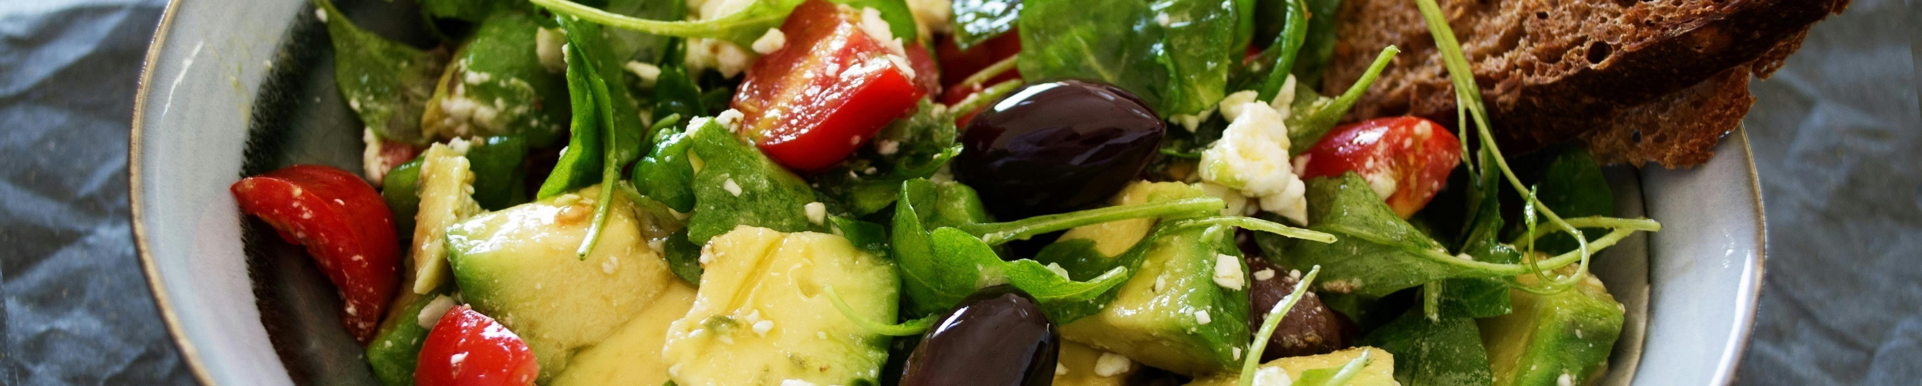
Growth factors of farm-to-fork global market size
The following slide represents growth factors of farm-to-fork global market size. It includes various factors such as demand for healthy food, increasing business investment, and shorter supply chains.
Consumer shift towards healthy food
Increasing business investment
Increasing demand for healthier and locally sourced food
Add text here
Surge in establishments of sustainable food businesses
Add text here
Shorter supply chains
Involvement of few intermediaries leads to lower cost
Add text here

Slide 19
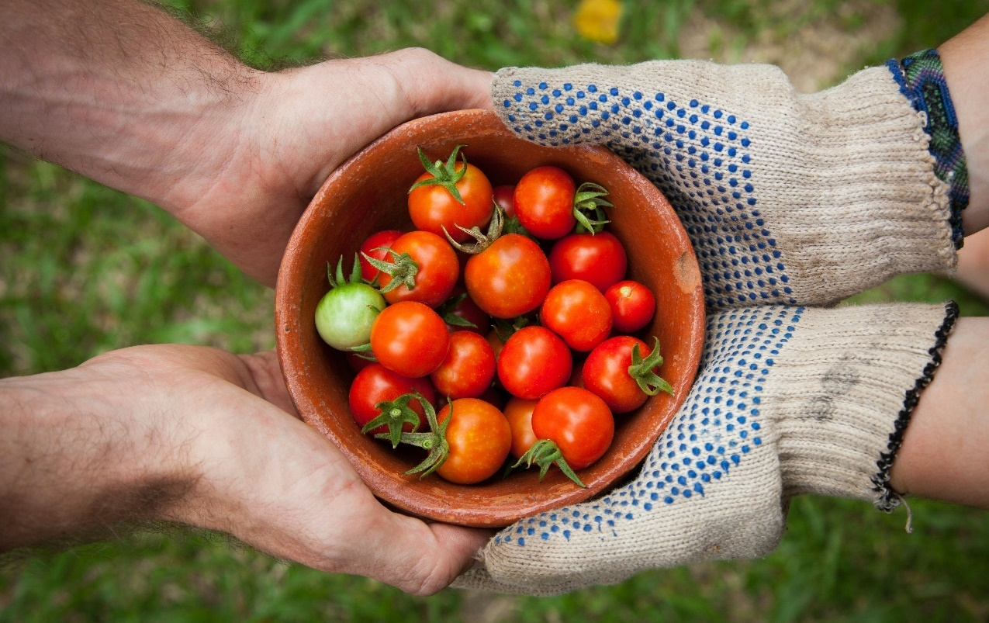
Industry statistics related to farm-to-table industry
1.86% Restaurants offer farm-to-table in their menus
APAC region have highest market share of 66.14%
The following slide represents industry statistics of farm-to-table industry. It includes various statistics related to restaurants, organic ingredients, dine-in, and highest contributing region.
68% People prefer to eat food sourced locally
00% Add text here
Add text here
13% Increase in global sales of organic products
00% Add text here
Add text here

Slide 20
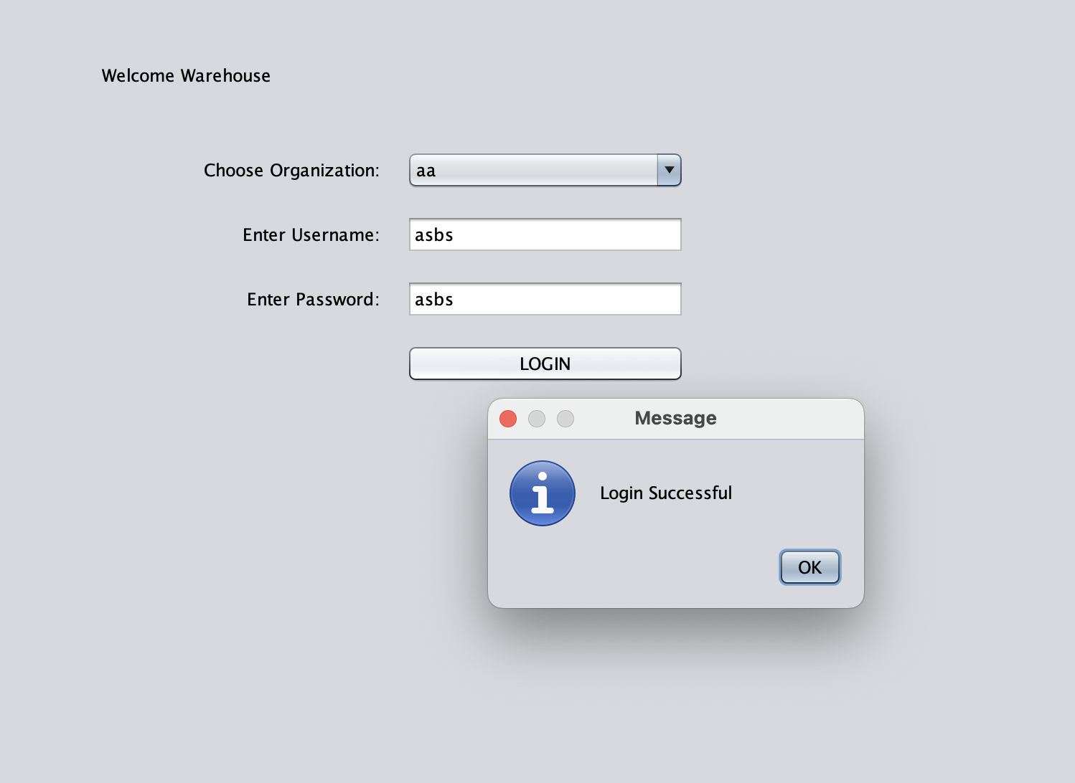
Warehouse Operator
Inventory Organization and Storage: Tools to organize and store goods efficiently, ensuring maximum space utilization.
Maintenance of Temperature-Controlled Facilities: Systems to monitor and maintain cold storage and temperature-sensitive products.
Monitoring Stock and Expiry Dates: Alerts and tracking systems to monitor product expiry dates and prevent wastage.

Slide 21
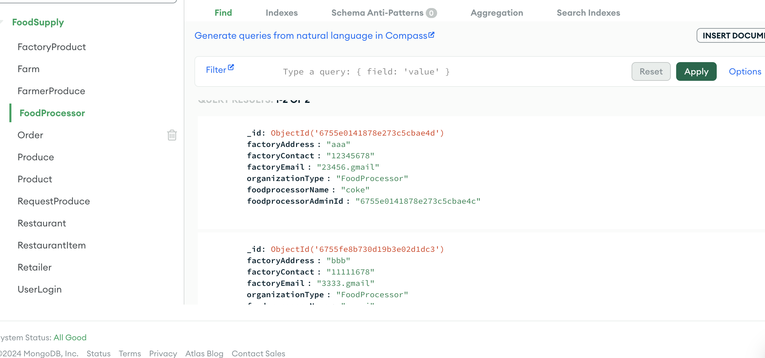
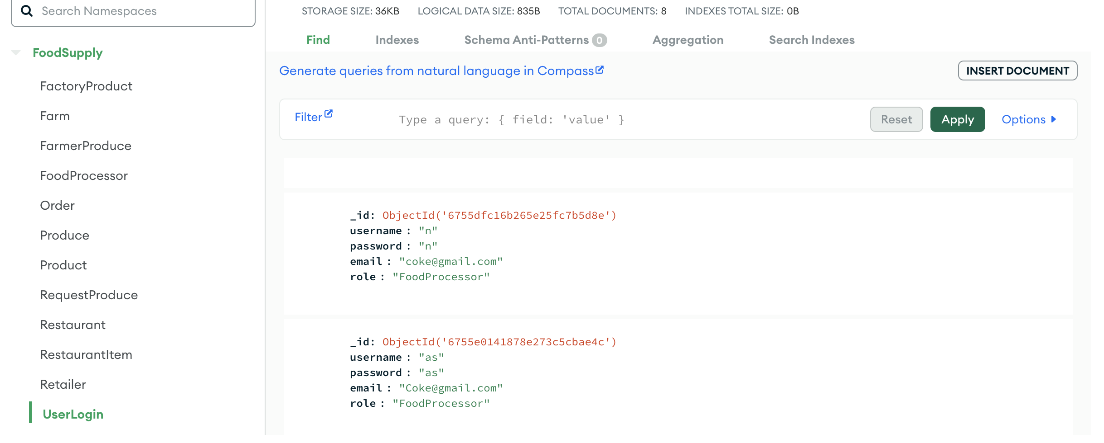
Data storage

Slide 22

Analyzing current performance of farm-to-table KPIs
KPIs
Current performance
Desired performance
Percentage of sourced products from nearby farms
75%
85%
Number of markets attended
52 per year
70 per year
Amount of products unsold
5%
2%
The following slide showcases analyzing current performance of farm-to-table KPIs. It includes various KPIs such as percentage of produce sourced from nearby farms, number of farmers’ market attended, amount of produce unsold, and percentage of repeat customers from local establishments.
Percentage of repeat customers from local establishments
60%
78%

Slide 23
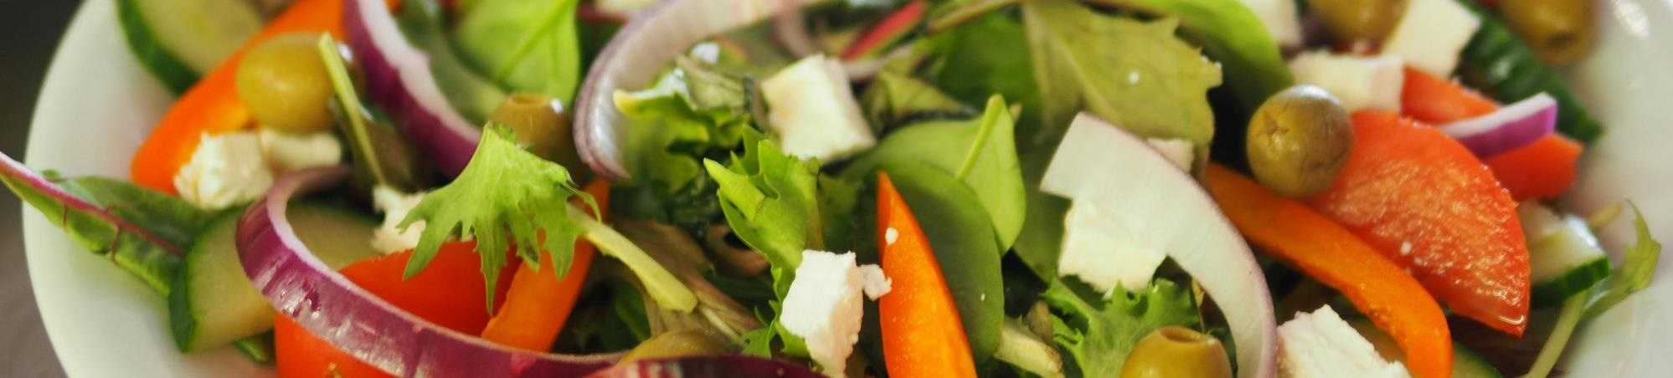
Identifying strategies to improve farm-to-table movement
The following slide showcases solutions and strategies to improve farm-to-table movement. It includes various solutions such as involving key stakeholders, seasonal demand forecasting, traceability and supply chain optimization, etc.
Involving key stakeholders
Fostering local networks
Seasonal demand forecasting
Traceability and supply chain optimization
Collaborate across the supply chain for
Transparency and efficiency
Add text here
Partner with local suppliers to
Create shorter supply chains
Add text here
Use data to predict
Seasonal shifts in consumer demand
Add text here
Implement technology to
Streamline logistics
Add text here

Slide 24
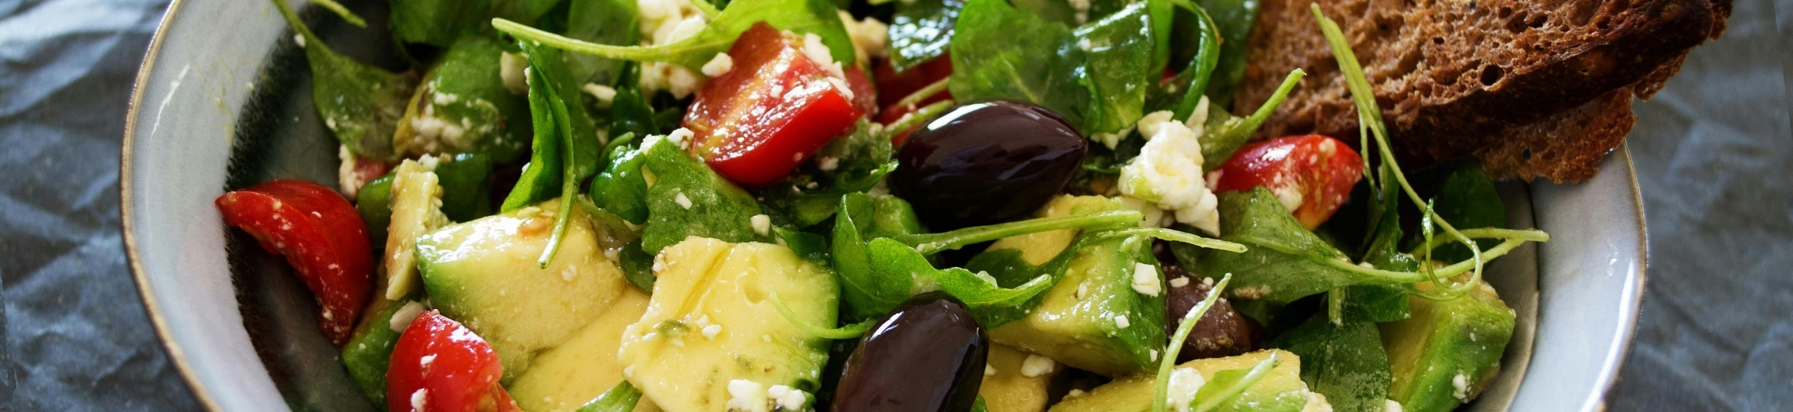
Fostering collaboration to improve synergy in farm-to-table supply chain
The following slide showcases methods for establishing collaboration to improve synergy in farm-to-table supply chain. It includes various methods such as shared goals and interests, incentive alignment, training and education, regular communication, and partnership opportunities.
Shared goals and interests
Incentive alignment
Training and education
Regular communication
Partnership opportunities
Identify common interests for collaboration
Focus on sustainability and efficiency
Add text here
Create incentives to adopt sustainable practices
Offer tax breaks, financial rewards
Add text here
Provide necessary training and resources
Assist stakeholders understand their role
Add text here
Establish open lines of communication
Share information, discuss challenges and solutions
Add text here
Facilitate partnerships among stakeholders
Create shared value and opportunities
Add text here

Slide 25
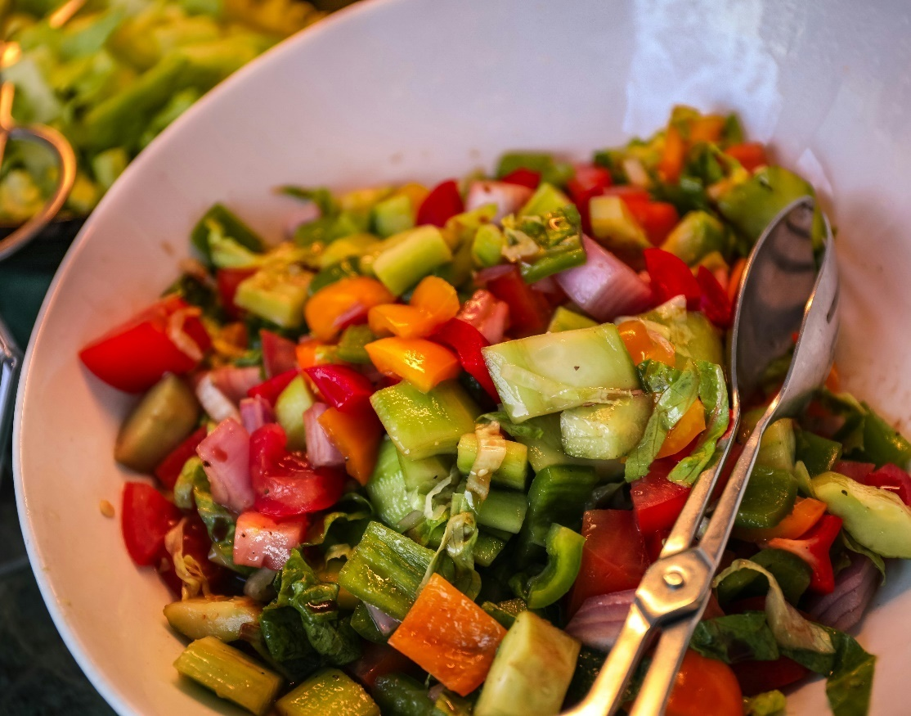
Stakeholders and their roles in farm-to-table supply chain
Stakeholder
Role
Potential actions
Adopt sustainable practices
Offer transparency
Add text here
Farmers
Produce healthy and safe food
The following slide showcases stakeholders and their roles in farm-to-table supply chain. It includes various stakeholders such as farmers, processors, distributors, retailers, and consumers.
Transform raw produce into finished products
Ensure ethical practices
Maintain traceability
Add text here
Processors
Bridge gap between farms and retailers
Optimize logistics
Reduce waste
Add text here
Distributors
Display and sell food to consumers
Support local farmers
Promote transparency
Add text here
Retailers
Purchase and consume food
Make informed choices
Demand transparency
Add text here
Consumers

Slide 26
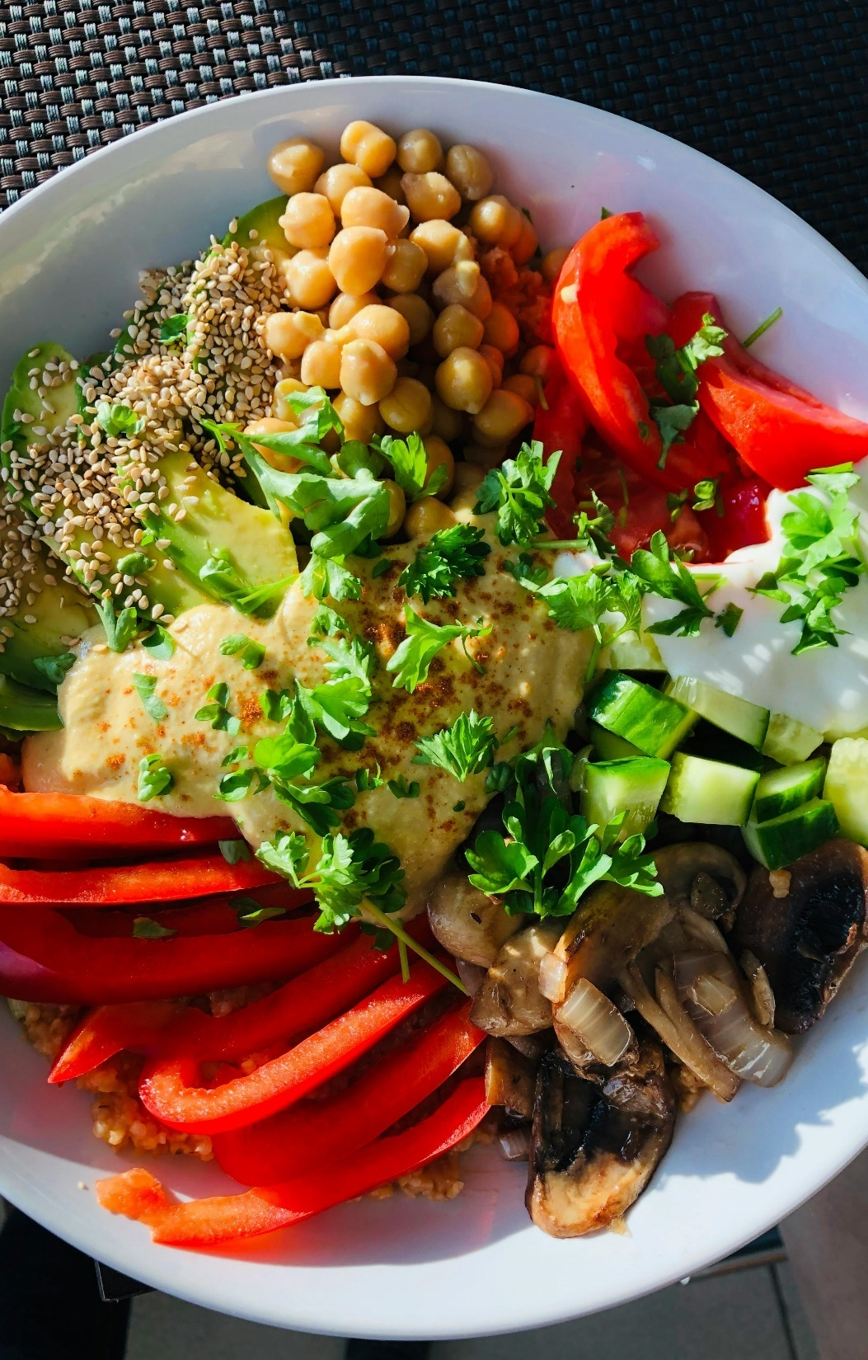
Technologies for implementing traceability in farm-to-table supply chain
Blockchain
Track food products throughout their lifecycle
Record supply chain from harvest to sale
Add text here
Digital tracking systems
Digitize tracking and integrate with other technologies
Provide comprehensive view of supply chain
Add text here
The following slide showcases technologies for implementing traceability in farm-to-table supply chain. It includes various technologies such as blockchain, digital tracking systems, IoT devices, etc.
IoT devices
Use sensors to monitor food conditions
Measure temperature and detect spoilage
Add text here

Slide 27
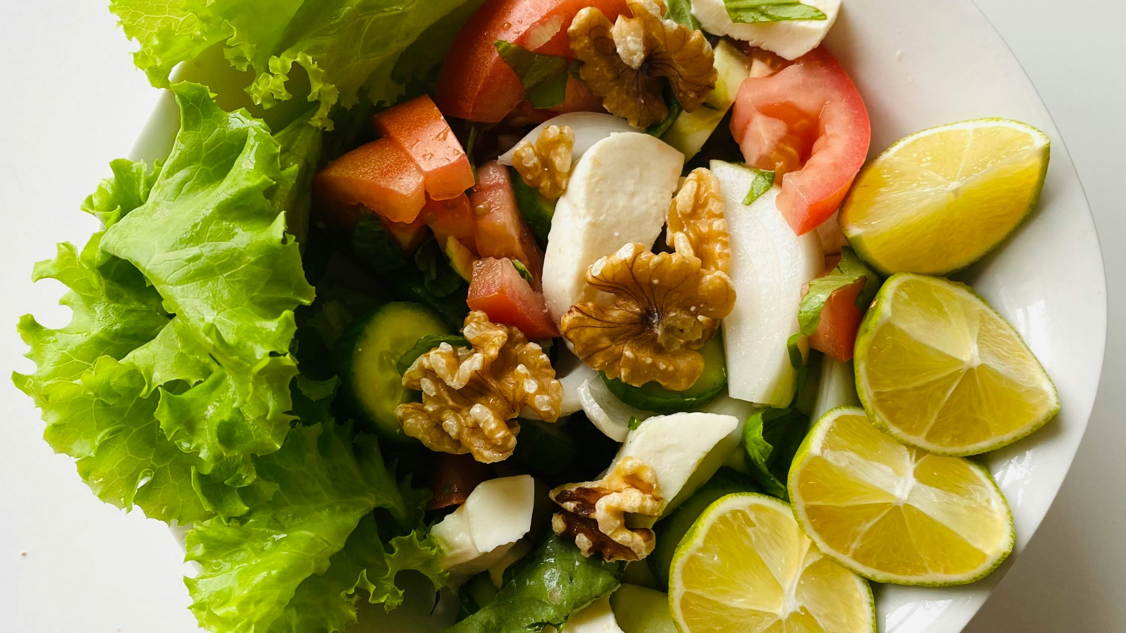
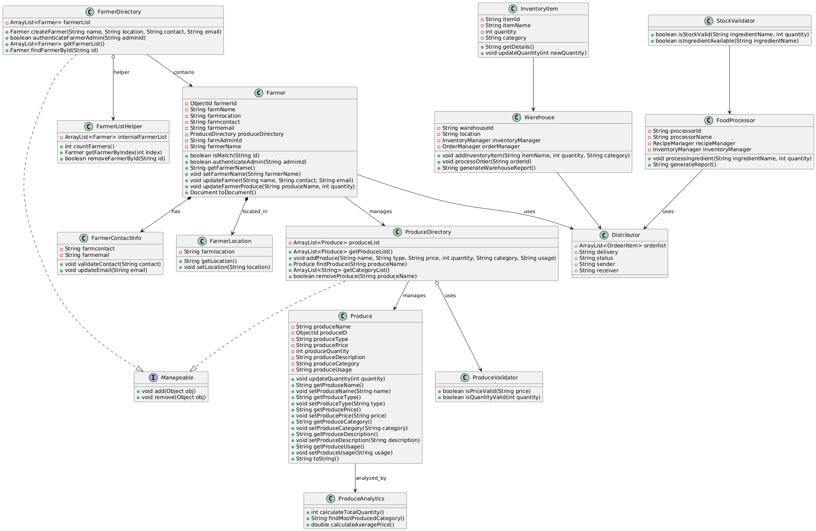
UML
The following slide represents impact of traceability and transparency in farm-to-table supply chain. It includes various effects such as boosting consumer confidence, improving food safety, and enhancing quality assurance.

Slide 28
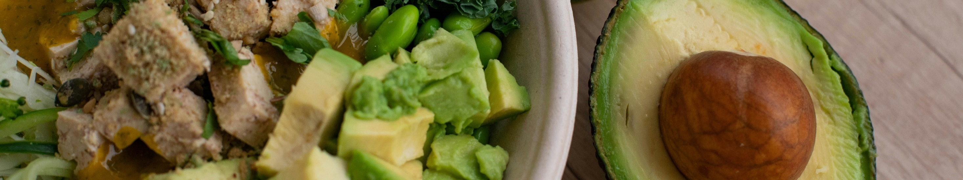
Methods for optimizing farm-to-table supply chain
The following slide represents methods for optimizing farm-to-table supply chain. It includes various practices such as data-driven decision making, supply chain optimization, consumer engagement, and digital farm management.
Data-driven decision making
Supply chain optimization
Consumer engagement
Digital farm management
Use data analytics for real-time insights
Assists in optimizing resource usage
Add text here
Incorporate technology to reduce inefficiencies
Leads to more sustainable distribution process
Add text here
Implement communication channels for collaboration
Ensures transparency with consumers
Add text here
Utilize farm management software for planning
Track crop rotations and farm productivity
Add text here

Slide 29
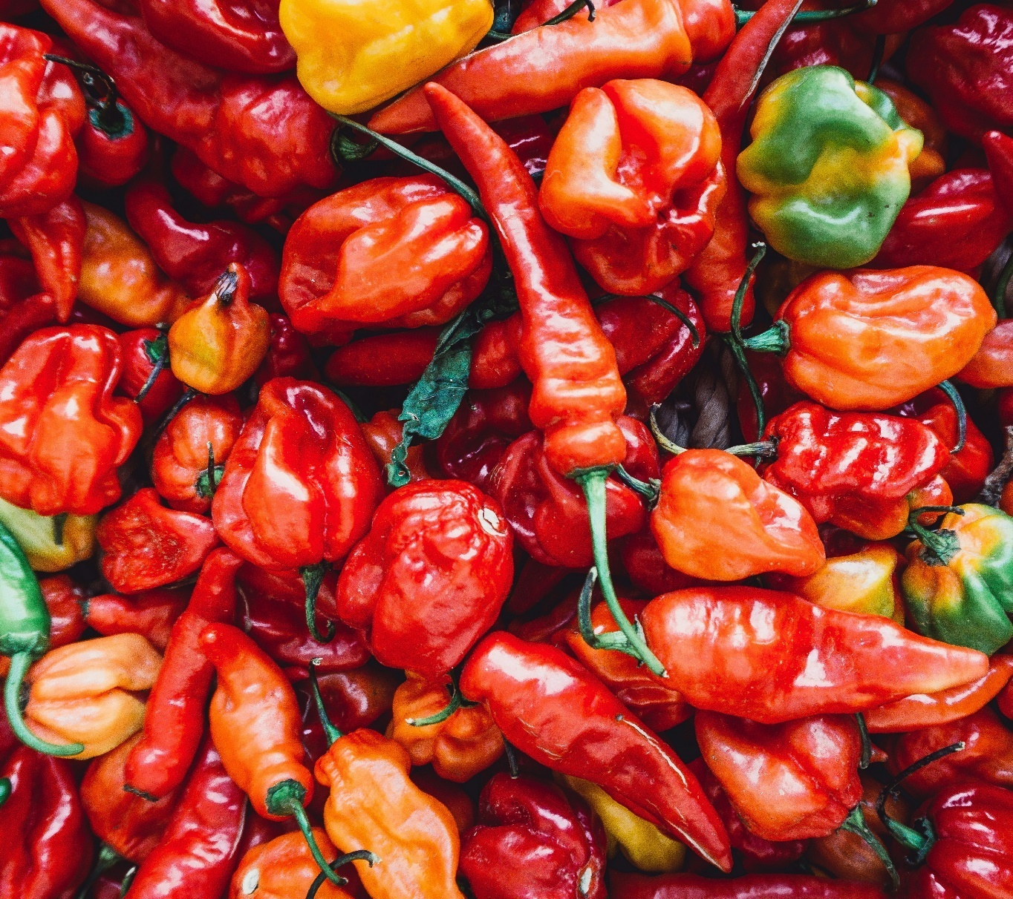
Advantages of local networks and short supply chains
Reduced transportation emissions
Shorter supply chains result in -
Fewer miles traveled
Reduced carbon emissions
Support for local economies
Creates opportunities for –
Small farmers
Local businesses
The following slide represents benefits of local food networks and short supply chains. It includes various advantages such as reduced transportation emissions, support for local economies, freshness and quality.
Freshness and quality
Locally sourced produce is more
Fresh and nutritional
Add text here

Slide 30
Impact of implementing short supply chains on farm-to-table KPIs
The following slide represents impact of implementing short supply chains on farm-to-table metrics. It includes various KPIs such as such as percentage of produce sourced from nearby farms, number of farmer's markets attended, amount of produce unsold, and percentage of repeat customers from local establishments.
Key reasons behind improvement
KPIs
Before
After
Desired
Percentage of sourced products from nearby farms | 75% | 83% | 85%
Number of markets attended | 52 markets per year | 72 markets per year | 70 markets per year
Amount of produce unsold | 5% | 2.1% | 2%
Percentage of repeat customers from local establishments | 60% | 77% | 78%
01
Improved demand forecasting of fresh food
02
Collaboration with local farms and producers
03
Increased traceability and transparency
04
Add text here Add text here

Slide 31

Key players in sustainable farm-to-table businesses
01
Otrafy
Resolves vendor related supply chain risks
Provides AI-based management system
Add text here
Develops farm-to-table delivery service for local sourcing
Facilitates direct-to-consumer nutritionally rich food
Add text here
02
RealEats
The following slide showcases examples of sustainable farm-to-table businesses. It includes various Otrafy, RealEats, Ositrade, Tsenso, and Farmizen.
03
Produces hardware-supported SaaS solution
Uses Bluetooth sensors to collect shelf insights
Add text here
Tsenso
04
Farmizen
Offers a subscription based farm-to-table
Creates shorter farm-to-table chains
Add text here

Slide 32
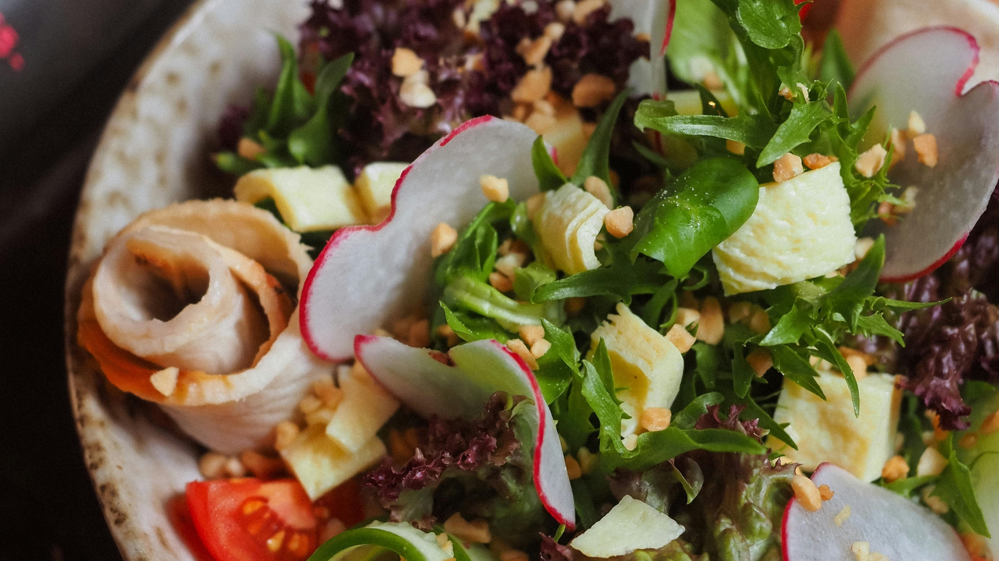

Thanks for watching!
Address
Contact number
Email address
# street number, city, state
0123456789
emailaddress123@gmail.com

